Slide 1
ONLINE CITY TOUR GUIDE APPLICATION
PRESENTED BY
K.DURGA RAO

Slide 2
Index
Abstract
Existing System
Drawbacks Of Existing System
Proposed System
Features Of Proposed System
Software Requirements
Hardware Requirements
Modules
UML Diagrams
Forms
Reports
Test Cases
Conclusion

Slide 3
ABSTRACT

Slide 4
Abstract
City Tour Guide is provides the all the information about the cities.
It is very useful for the tourism system, in current tourism system, whenever a tourist visits famous spots, to know more about the place the hires a guide.
The hired guide then narrates history of the places.The proposed system doesn’t require a physical guide.
The mobile application installed on the user mobile then tourist can act as a guide.
This application contains the information about famous places like temples, parks, beaches and etc. The android based city guide system has more practical significance.

Slide 5
EXISTING SYSTEM

Slide 6
Existing System
In the existing system the details of the metro for different cities is available in different applications.
The user has to go around searching for the application that contains the details of the required city.
It is time consuming to search the details in this manner. Similarly details such as nearby hotels and hospitals are not available in a single application.

Slide 7
Disadvantages
Individual application for particular city.
Full version of application is paid one.
Needs internet connection for its accessing.
Finding the nearest hotel and hospital not possible.

Slide 8
PROPOSED SYSTEM

Slide 9
Proposed System
The proposed system entitled as "City Tour Guide" is an online application". In the proposed system the details of the cities is shown in a single application.
It provides the famous location information of cities, and other details. The nearest hotels and the nearest hospitals for the particular place are shown to make the journey of the user easy.
It displays the Locations as per user's choice. In this proposed system user can act as a guide.
Users can access the information through on database. The software can record data in the database, display Cities information; Famous Places information, and many more.

Slide 10
Advantages
Major city details in a single application.
Complete online application.
Open source.
Searching facility.
Doesn’t require a physical guide.

Slide 11
HARDWARE REQUIREMENTS
Processor Type : Pentium IV
Memory (RAM) : 4GB
Hard Disk : 500GB
Drive : CD-ROM Drive
Display : 32-bit color Monitor
Modem Speed : 36KBPS

Slide 12
SOFTWARE REQUIREMENTS
Operating system : Microsoft Windows7.
Platform of development : Android studio
Database : Oracle10g
Web Browser : Internet Explorer 8.0
Front end : Android
Back end : My SQL,JSP
Web Server : Apache Tomcat 8.

Slide 13
Modules
Administration Module
Place Detection
Routing Module
Travelling Module
Rating Module

Slide 14
Module Description
Administration Module:
Administrator maintains the all the activities in this system. New changes are occurred those are maintained by the administrator.
Admin will have login form that can enter user name and password to view other features. After login is completed admin can Adding new places and deleting old places etc.
In this module administration has done the following job like maintaining all the information about the cities. The admin has overall rights over the system and can modify, delete any details. Admin can see the user ratings.

Slide 15
Module Description
Place Detection Module:
This module provides famous visiting places near to the selected location and also provides details about hotels, hospitals, shopping malls and so on.
User will be select the famous locations in this Module.
User (tourist) can search the famous place in this module. The user should able to search appropriate locations. The user should be able to retrieve the very best activities for the selected city.
The user can also be able to retrieve full information for any selected option. If don’t have an idea about the place then user can search the places in a cities.
Users have to search the states option first after that he/she selects the one city. Selected city information is displayed on the screen.

Slide 16
Module Description
Routing Module:
This module provides route information to the selected place.
The Route can display on the with in the using of GPS system.
User can easily trace the famous locations in this module. The user must be search the route to reach location spots.
The user can also able to retrieve the full information for the any selected city routes. All the Cities route information is available in this module.
This module provides route information to the selected place.

Slide 17
Module Description
Traveling Module:
Traveling Module provides the information about the available vehicles present in the user selected city.
This module provides the vehicular information, travels information, distance information, time and cost information to reach a place, sites those are used to select the vehicle and so on.

Slide 18
Module Description
Rating Module:
In this module the users gives rating to the application.
Giving rating is stored to database.
Admin can see the this rating in database.

Slide 19
UML DIAGRAMS

Slide 20
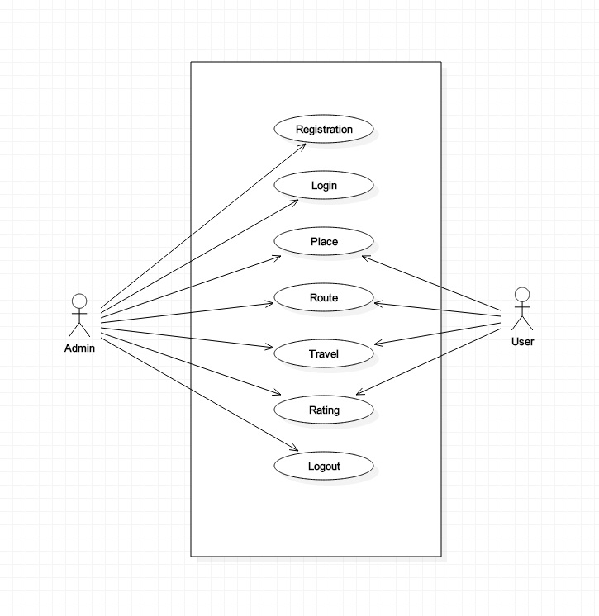
Use Case Diagram

Slide 21
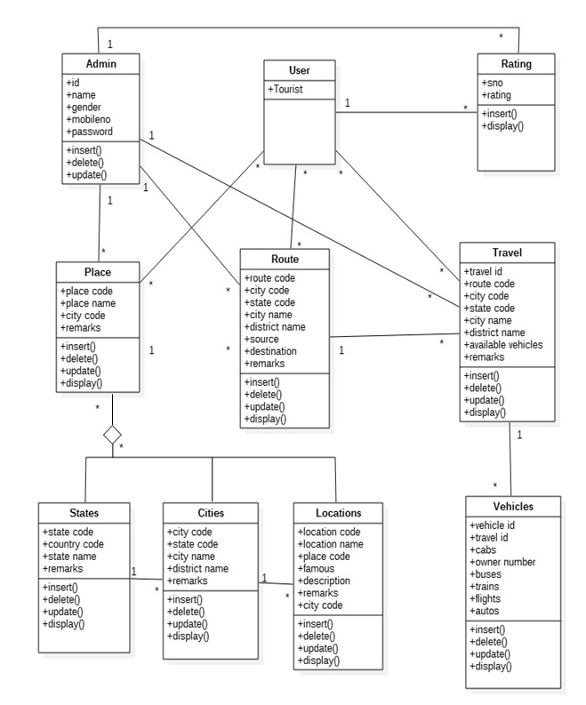
Class Diagram

Slide 22
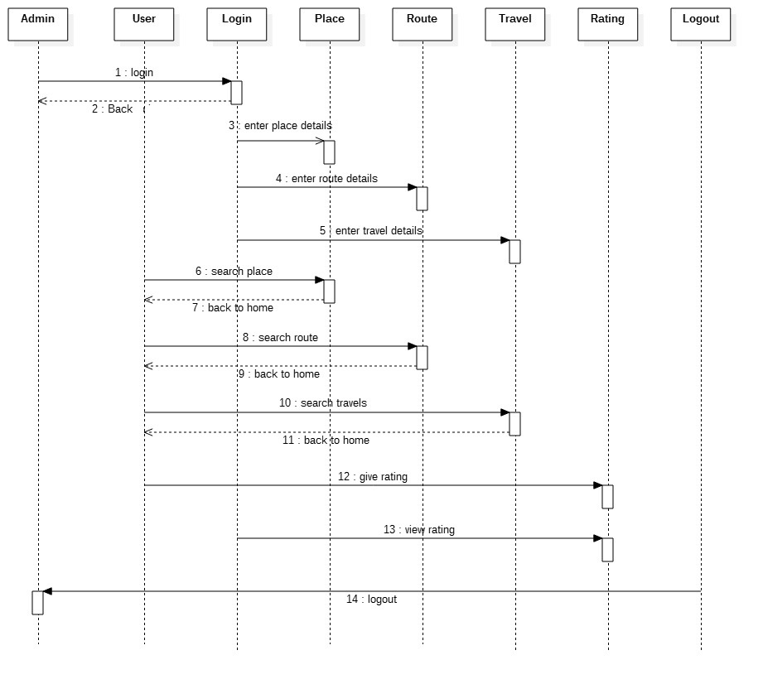
Sequence Diagram

Slide 23
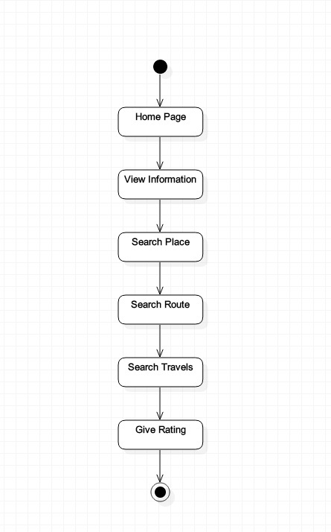
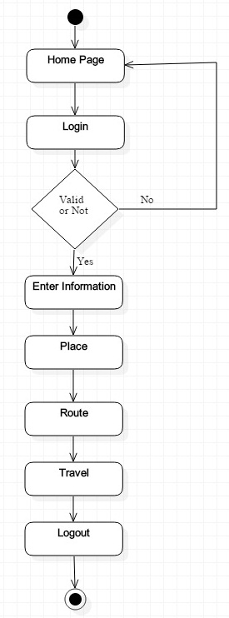
Activity Diagram

Slide 24
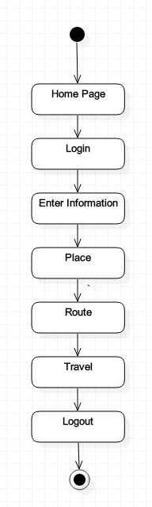
State Chart Diagram

Slide 25
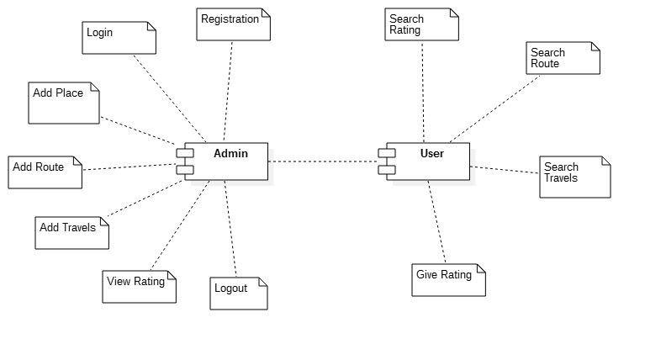
COMPONENT DIAGRAM

Slide 26
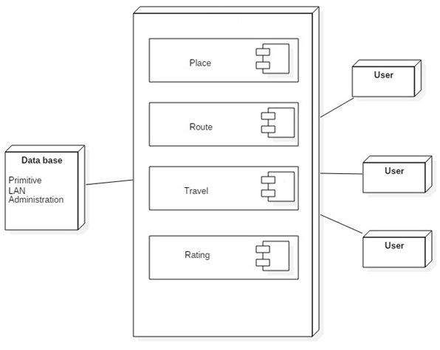
DEPLOYMENT DIAGRAM

Slide 27
FORMS

Slide 28
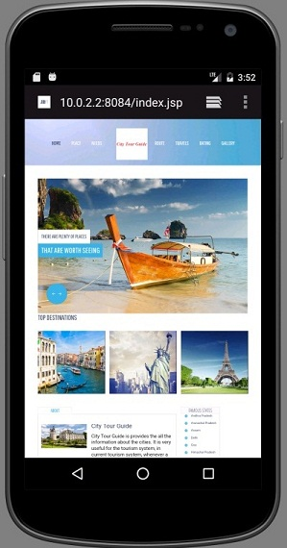
Home Page

Slide 29
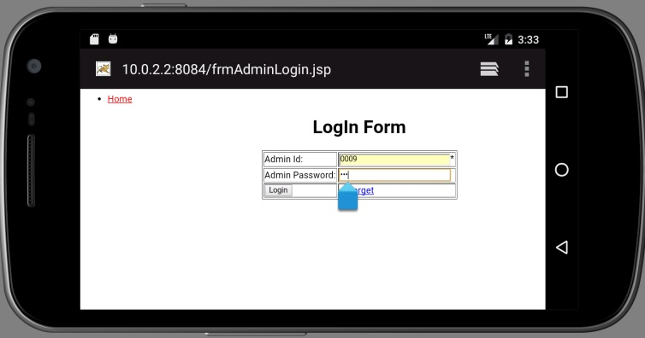
Admin Login Form

Slide 30
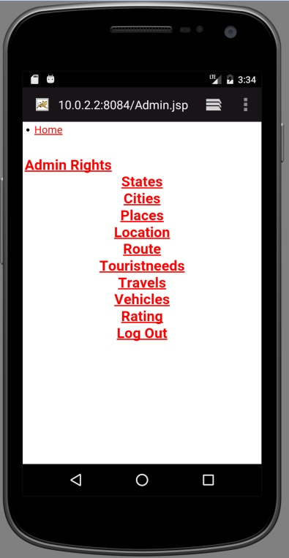
Home Page For Administration

Slide 31
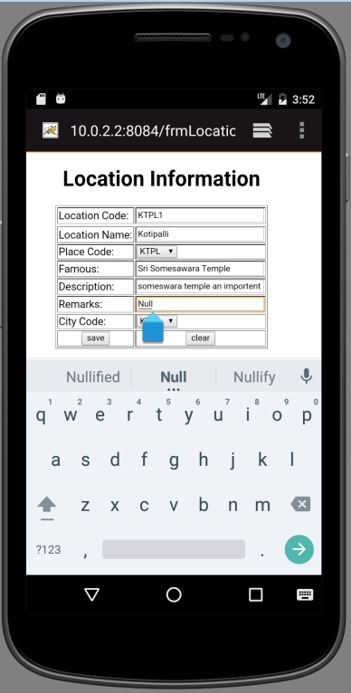
Data Insert Form

Slide 32
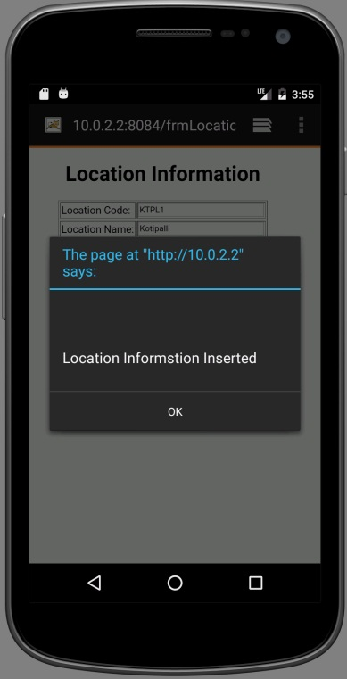
Data Insert Form

Slide 33
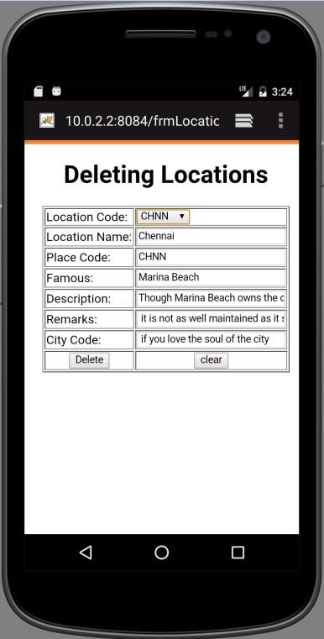
Data Delete Form

Slide 34
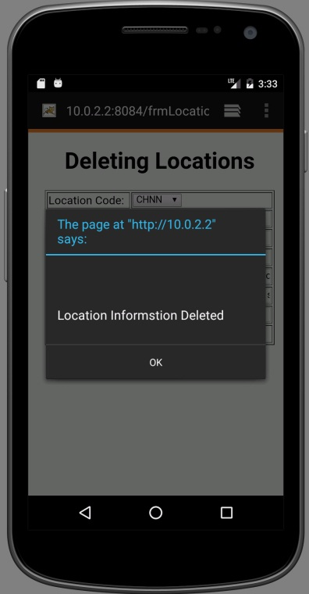
Data Delete Form

Slide 35
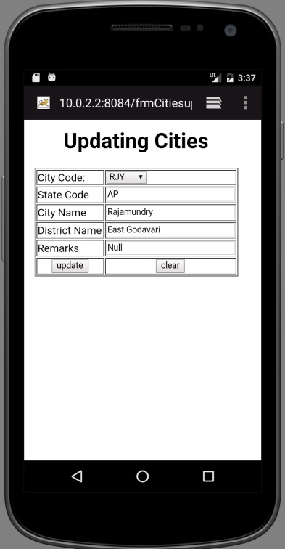
Data Update Form

Slide 36
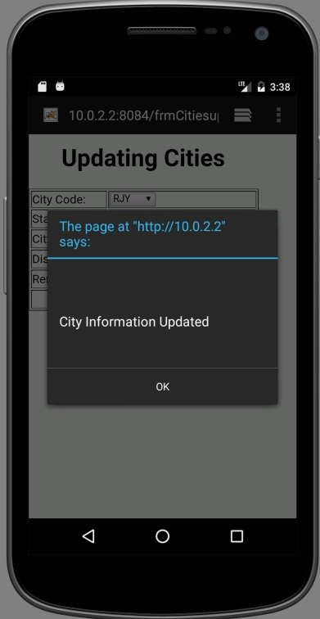
Data Update Form

Slide 37
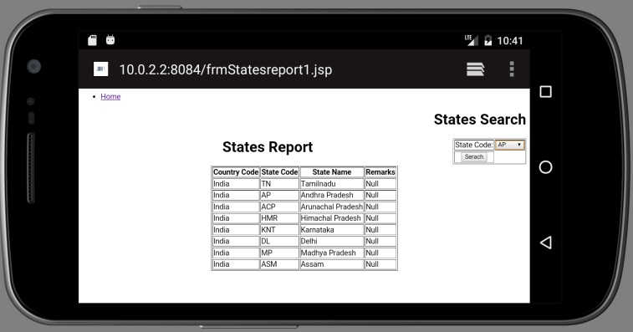
User Process

Slide 38
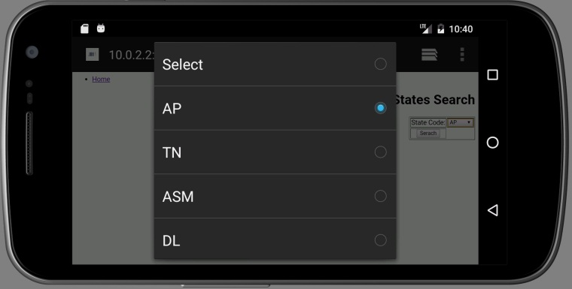
User Process

Slide 39
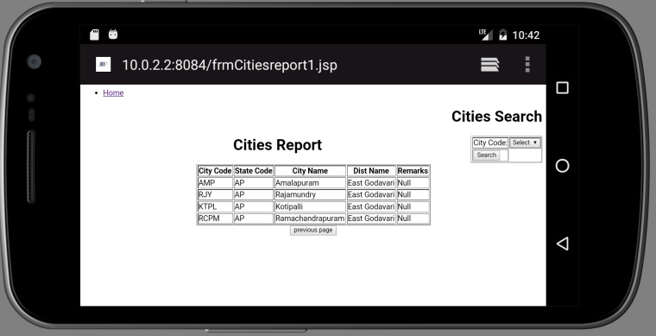
User Process

Slide 40
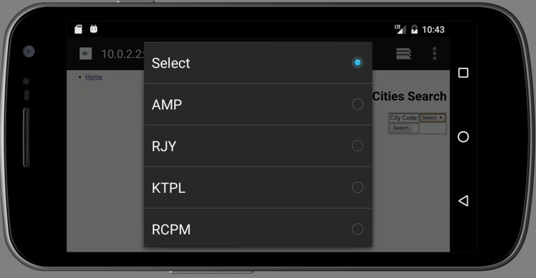
User Process

Slide 41
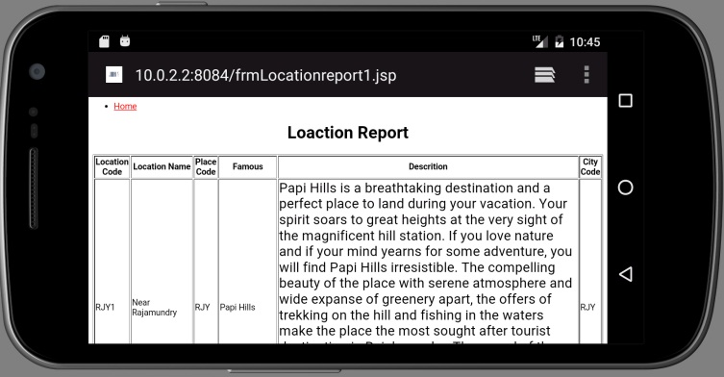
User Process

Slide 42
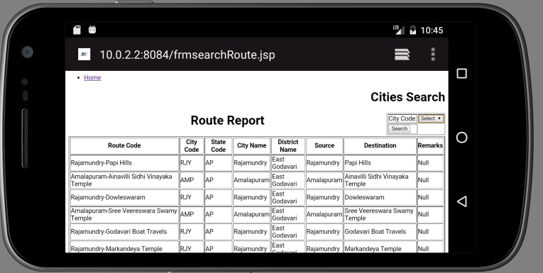
User Process

Slide 43
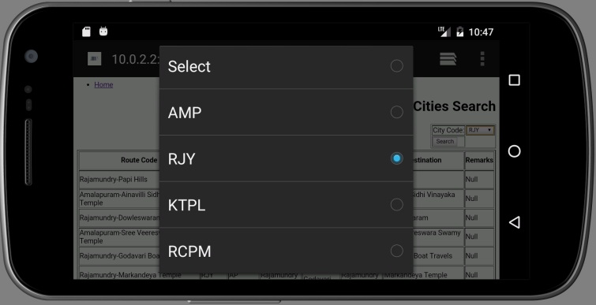
User Process

Slide 44
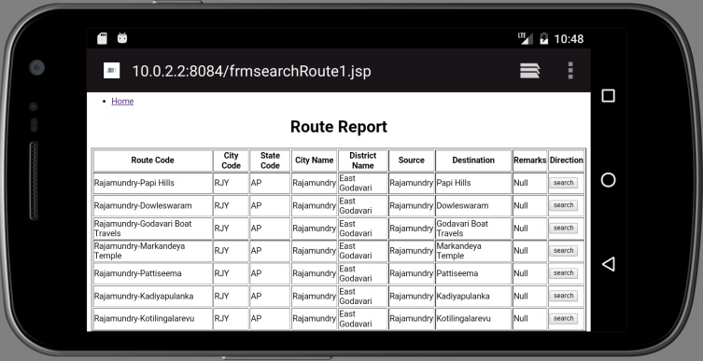
User Process

Slide 45
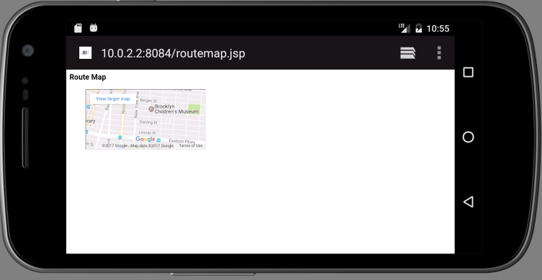
User Process

Slide 46
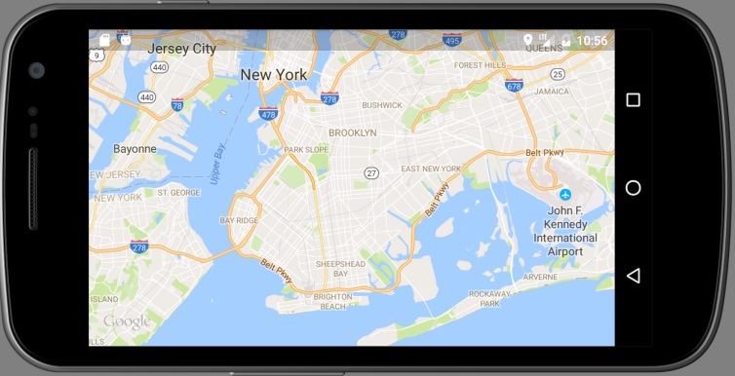
User Process

Slide 47
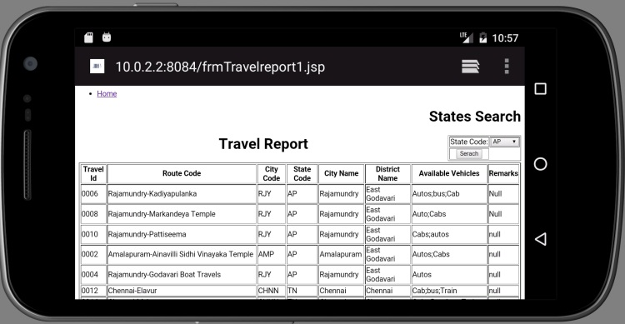
User Process

Slide 48
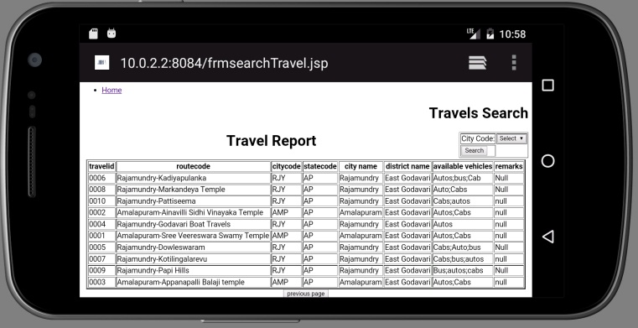
User Process

Slide 49
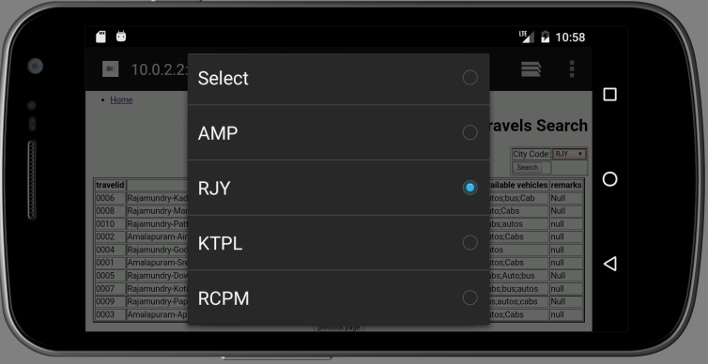
User Process

Slide 50
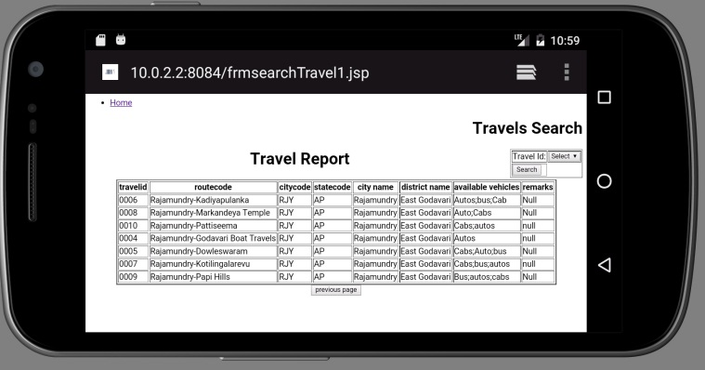
User Process

Slide 51
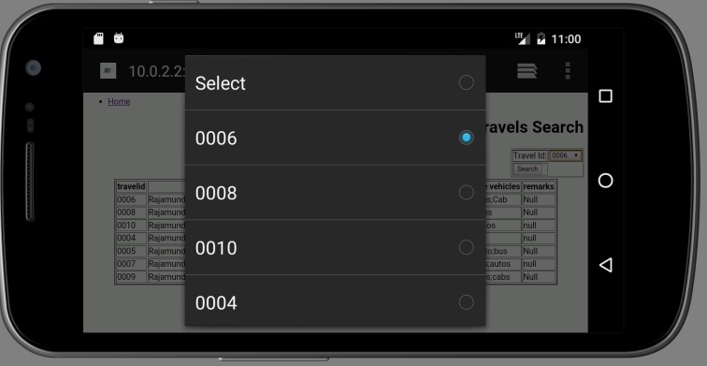
User Process

Slide 52
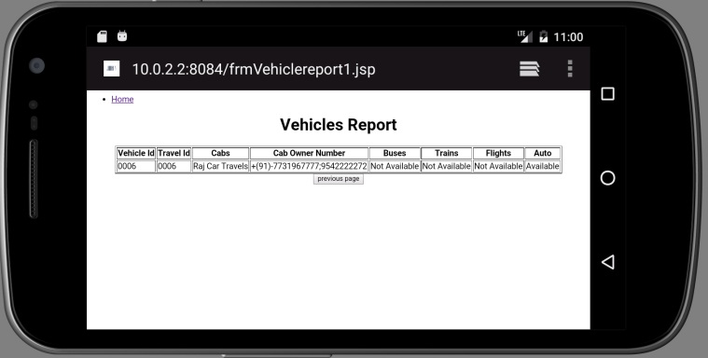
User Process

Slide 53
REPORTS

Slide 54
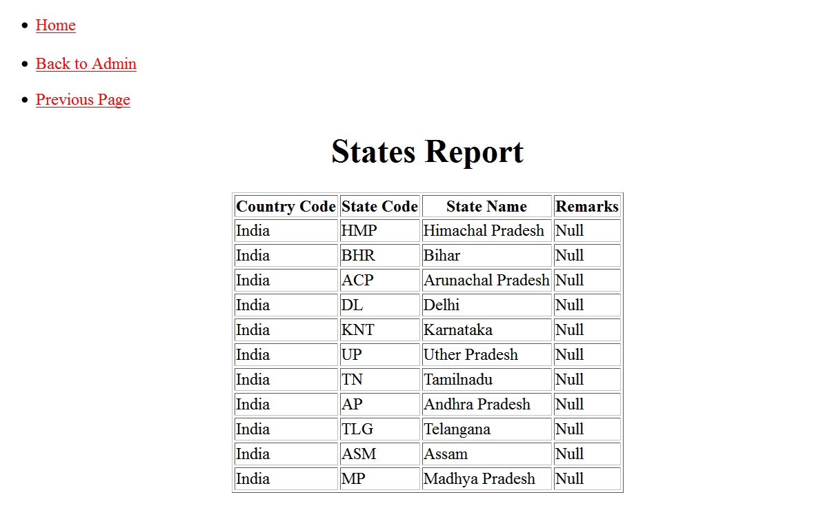
States Report

Slide 55
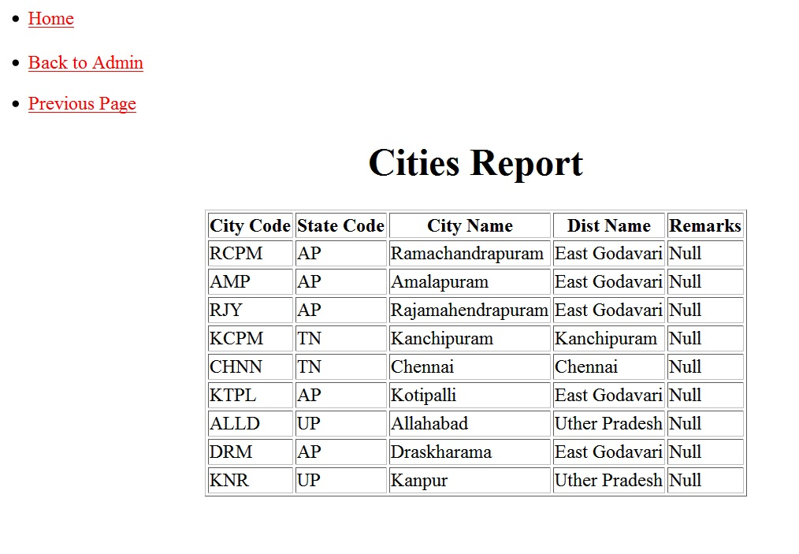
Cities Report

Slide 56
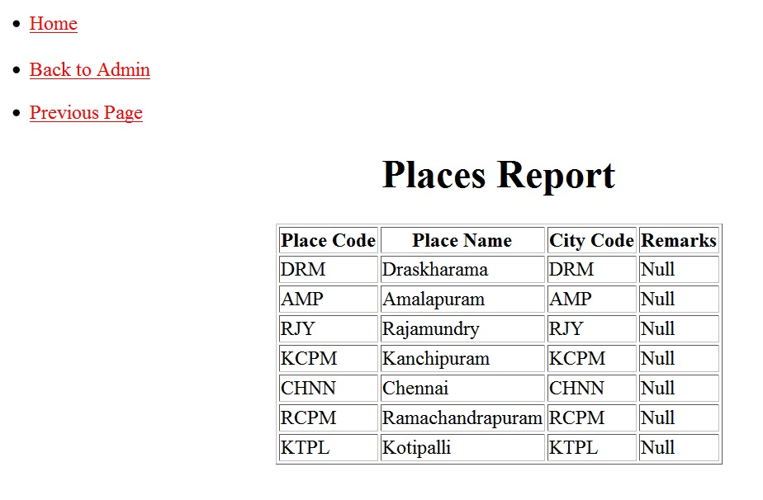
Places Report

Slide 57
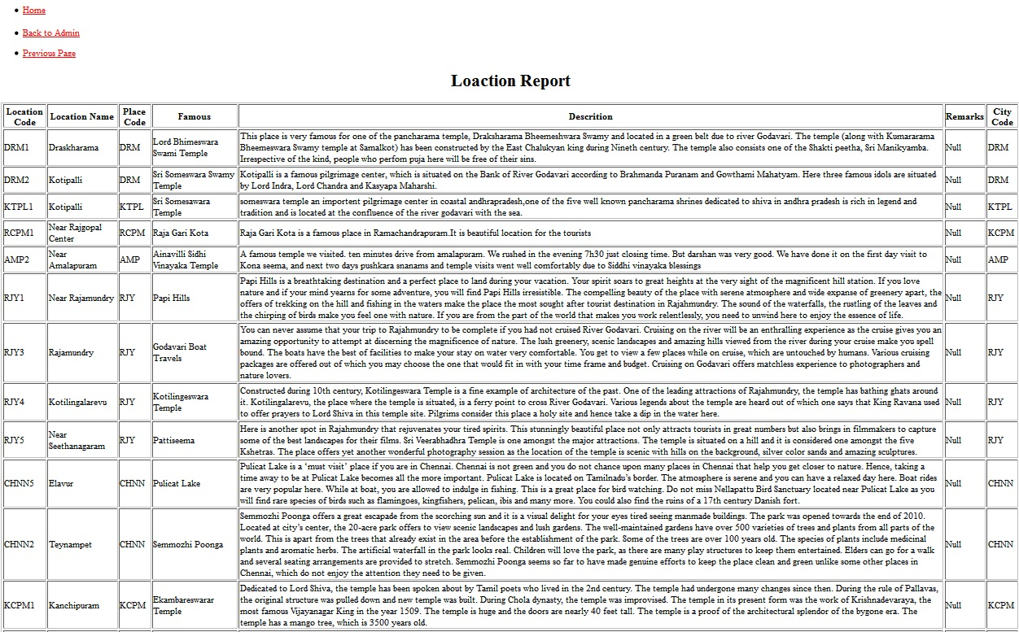
Location report

Slide 58
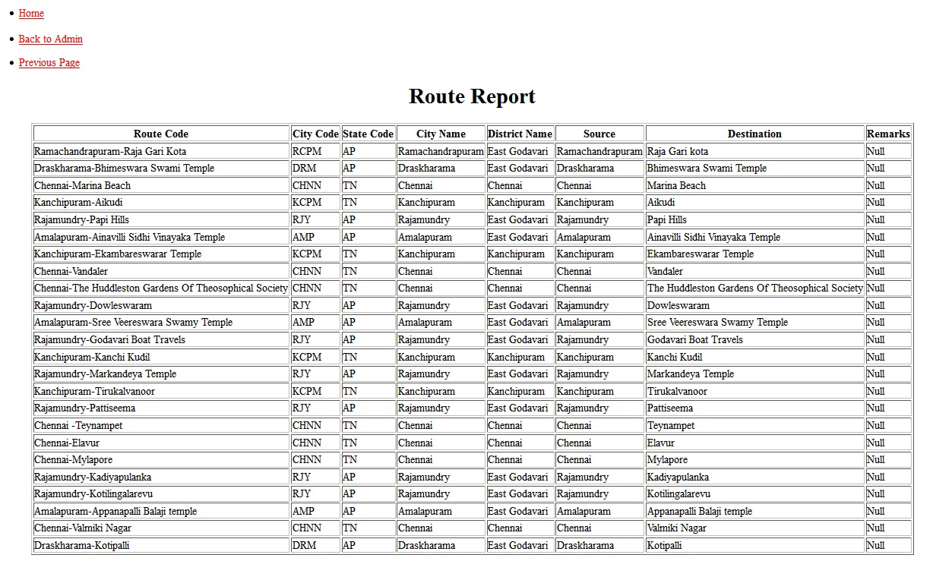
Route report

Slide 59
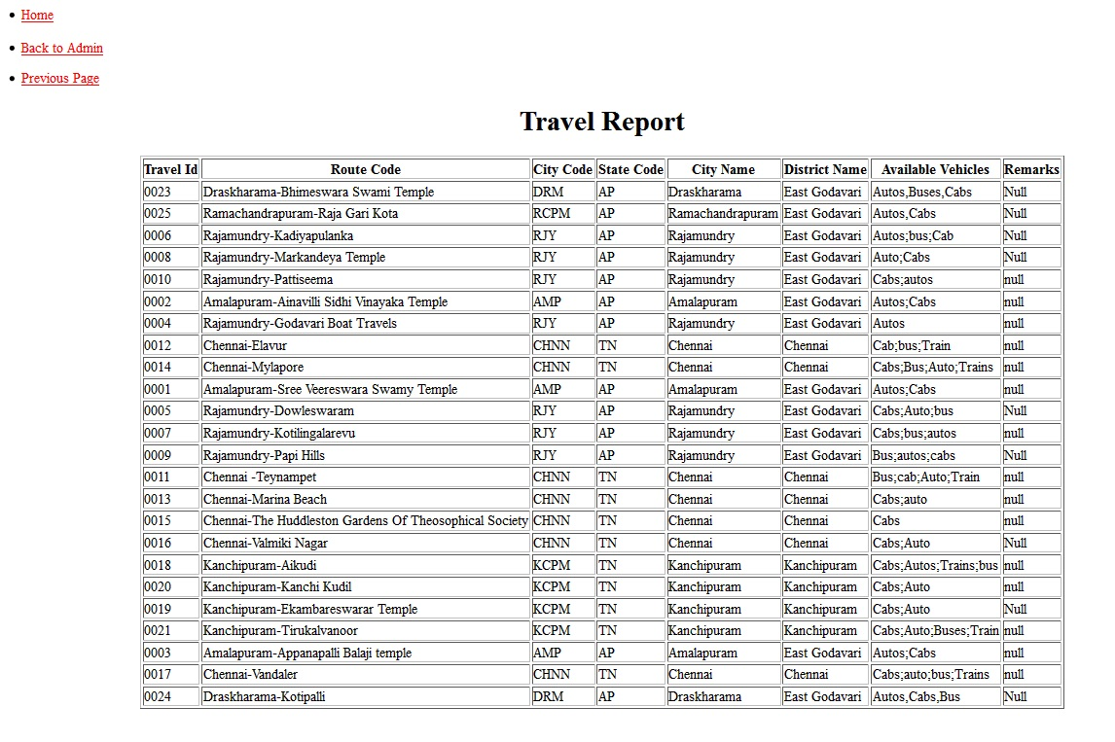
Travel report

Slide 60
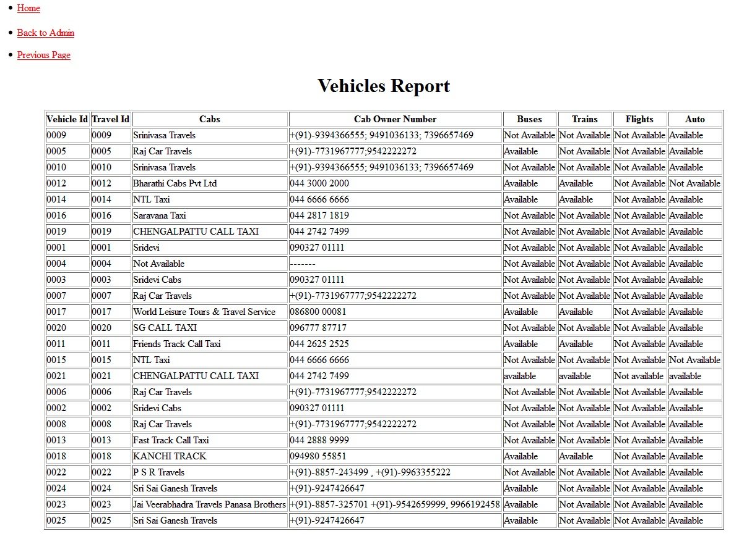
Vehicles report

Slide 61
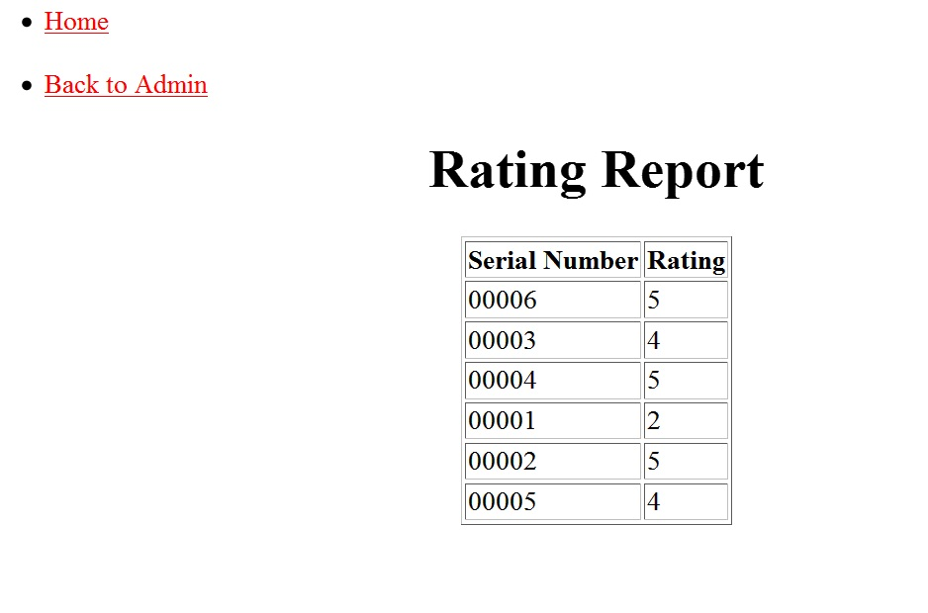
Rating report

Slide 62
TEST CASES

Slide 63
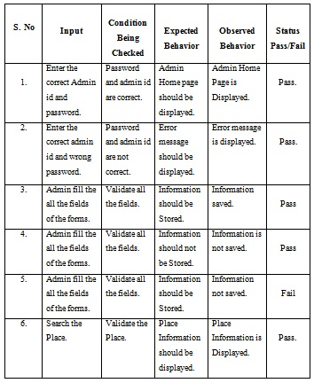
Test Cases

Slide 64
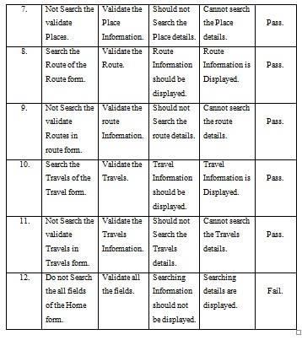
Test Cases

Slide 65
CONCLUSION

Slide 66
CONCLUSION
This system provides the information query of Places, Routes, travels, Live Locations and so on. The system is a combination of Smart-phone and Internet to facilitate the tour of user.
The implementation of this project reduces the over expenditure of such companies and makes economical balance.
This project” Online City Tour Guide Application” is very helpful to the Tourists. The reports generated by this project are helpful to the Users.
This project is very user friendly, effective and efficient software.

Slide 67
THANK YOU

